Slide 1
Employee Salary Prediction
CAPSTONE PROJECT
Presented By:
Irakam Siva Venkata Bhanu Prakash
Roll no: - 22191A0515
JNTUA College of Enginnering Pulivendula
Computer Science and Engineering
AICTE Internship Student Registration ID : STU6798dd10d3b1f1738071312

Slide 2
OUTLINE
Problem Statement (Should not include solution)
System Development Approach (Technology Used)
Algorithm & Deployment (Step by Step Procedure)
Result
Conclusion
Future Scope(Optonal)
References

Slide 3
Problem Statement
Goal: Predict if an employee’s annual salary exceeds $50K using demographic, education and work‑related
attributes.
Inputs:
Age, gender, native country
Education level & years ,education
Workclass, occupation, hours‑per‑week, experience
Financials: capital‑gain, capital‑loss
Output: Binary salary class (≤ 50K vs. > 50K)
Why it matters:
Informs compensation budgeting & pay equity
Supports data‑driven HR decisions and talent management

Slide 4
System Approach
1. System Requirements
Hardware:
CPU: Quad‑core 2.5 GHz+
RAM: 16 GB (32 GB recommended)
Storage: 100 GB+ SSD
GPU (optional): NVIDIA GTX 1060/RTX series
Software & Environment:
OS: Windows 10/11, Ubuntu 20.04+, or macOS 10.15+
Python 3.8+ with virtual environment (venv/conda)
Git for version control

Slide 5
System Approach
2. Key Libraries
Data Handling & Preprocessing
pandas, numpy, scikit-learn (StandardScaler, OneHotEncoder)
Modeling & Evaluation
scikit-learn (Logistic Regression, Random Forest)
xgboost or lightgbm
joblib for model persistence
Visualization
matplotlib, seaborn
Deployment
FastAPI or Flask
Docker for containerization
CI/CD tooling (GitHub Actions)

Slide 6
Algorithm & Deployment
1. Algorithm
Data Preparation
Train/test split (e.g., 80/20)
Categorical encoding (One‑Hot, LabelEncoder)
Feature scaling (StandardScaler)
Model Selection
Logistic Regression
Baseline linear classifier
Random Forest Classifier
Ensemble of decision trees for non‑linear relationships
Evaluation Metrics
Accuracy, F1‑score
Precision, Recall

Slide 7
Algorithm & Deployment
2. Deployment
Model Serialization
Export trained pipeline with joblib.dump() (or pickle)
Web Application
Streamlit front end:
Load serialized model
User inputs via sliders/dropdowns
Real‑time salary‑class prediction display
Next‑Step Packaging (Optional)
Containerize with Docker for reproducible environments
CI/CD pipeline for automated testing & deployment

Slide 8
Result
Attach your Github link: - https://github.com/hynko431/Employee-Salary-Prediction
Attach screen snaps of the output in next slides

Slide 9
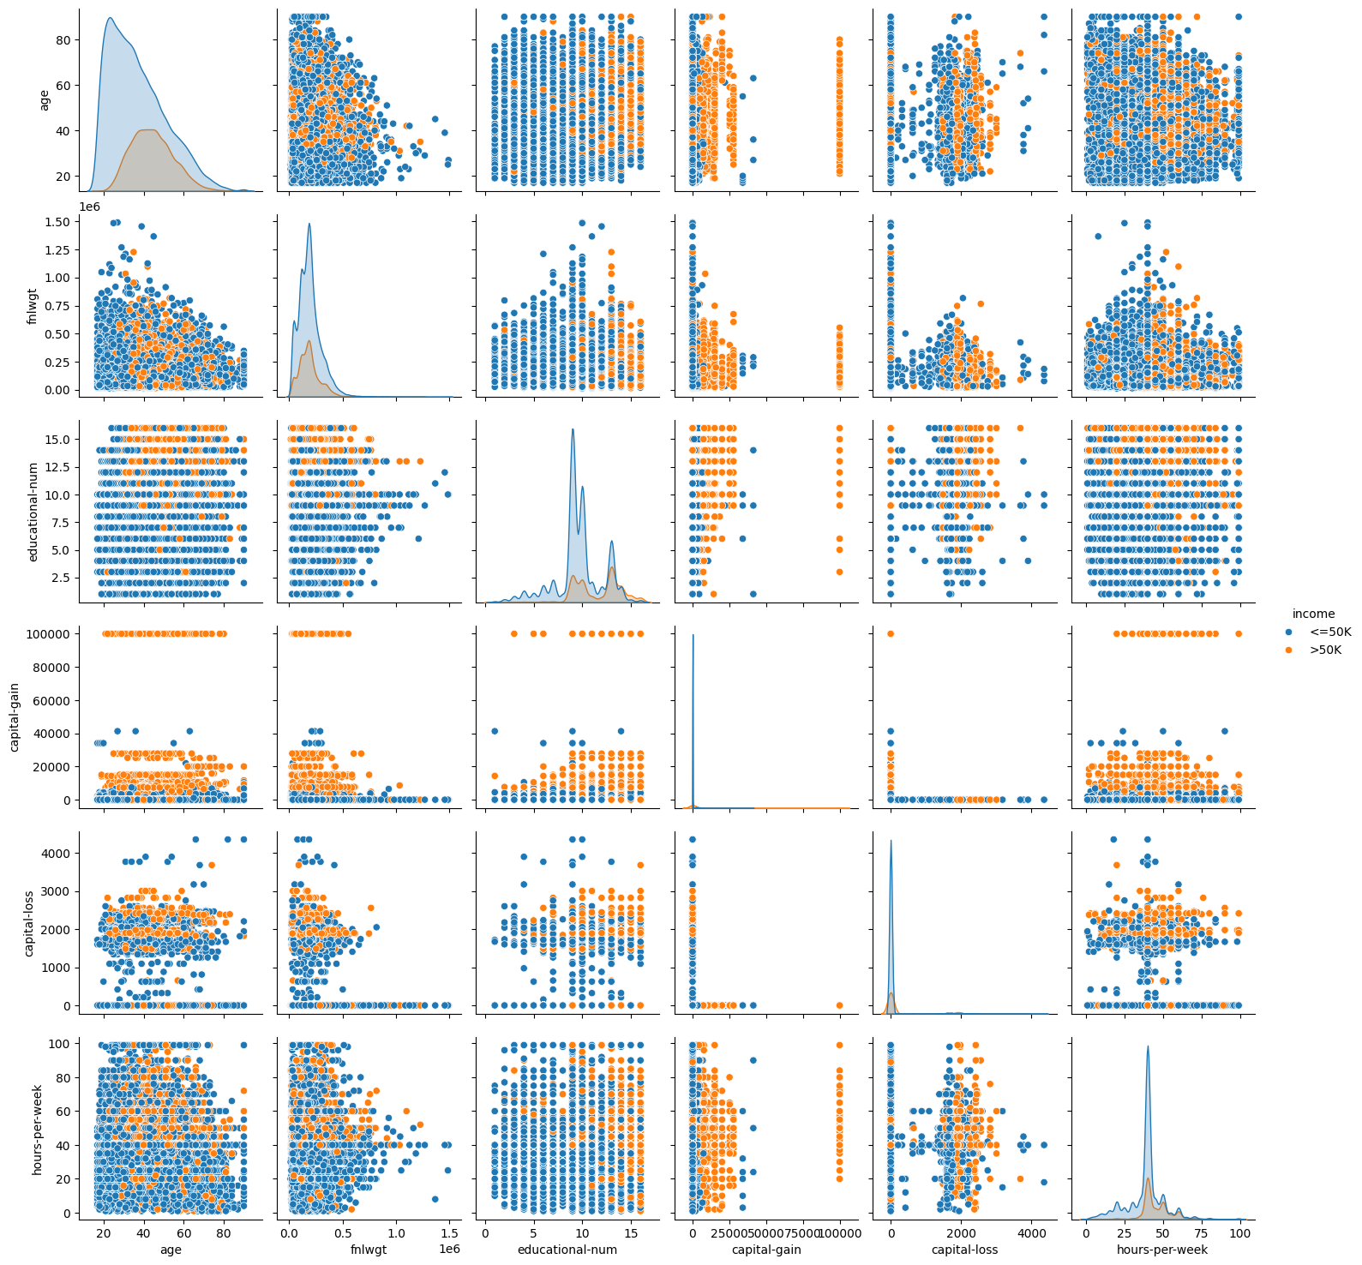
Result

Slide 10
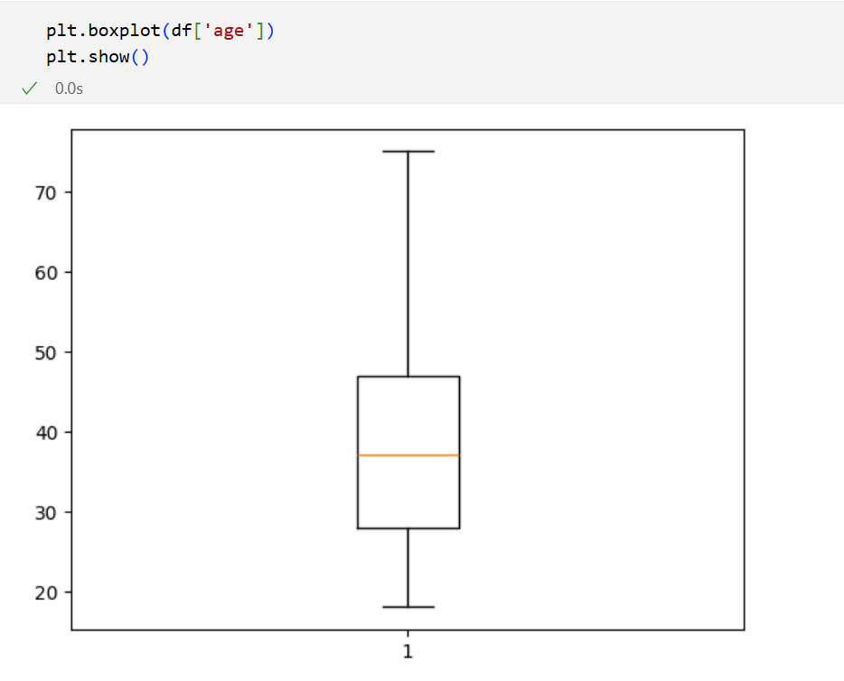
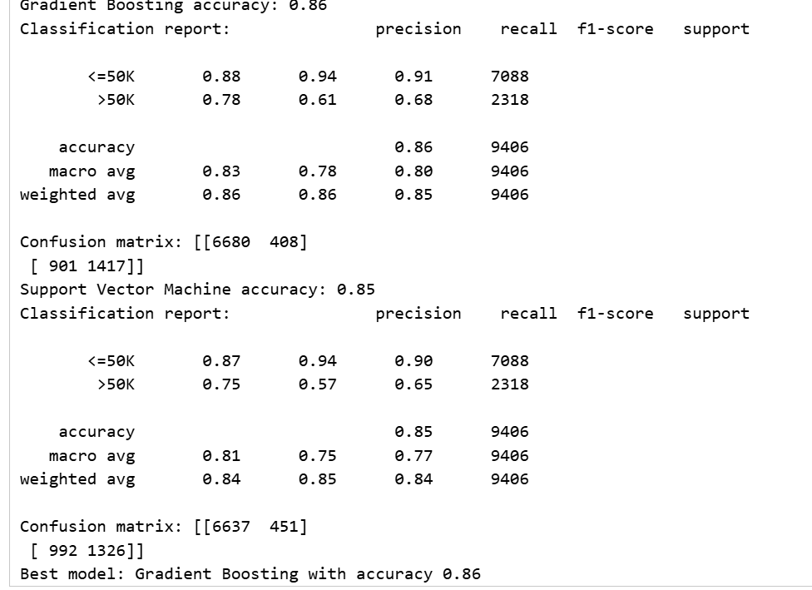
Result

Slide 11
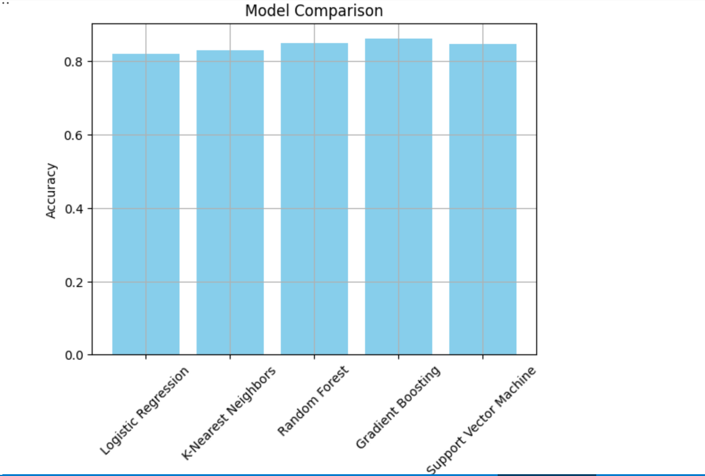
Result

Slide 12
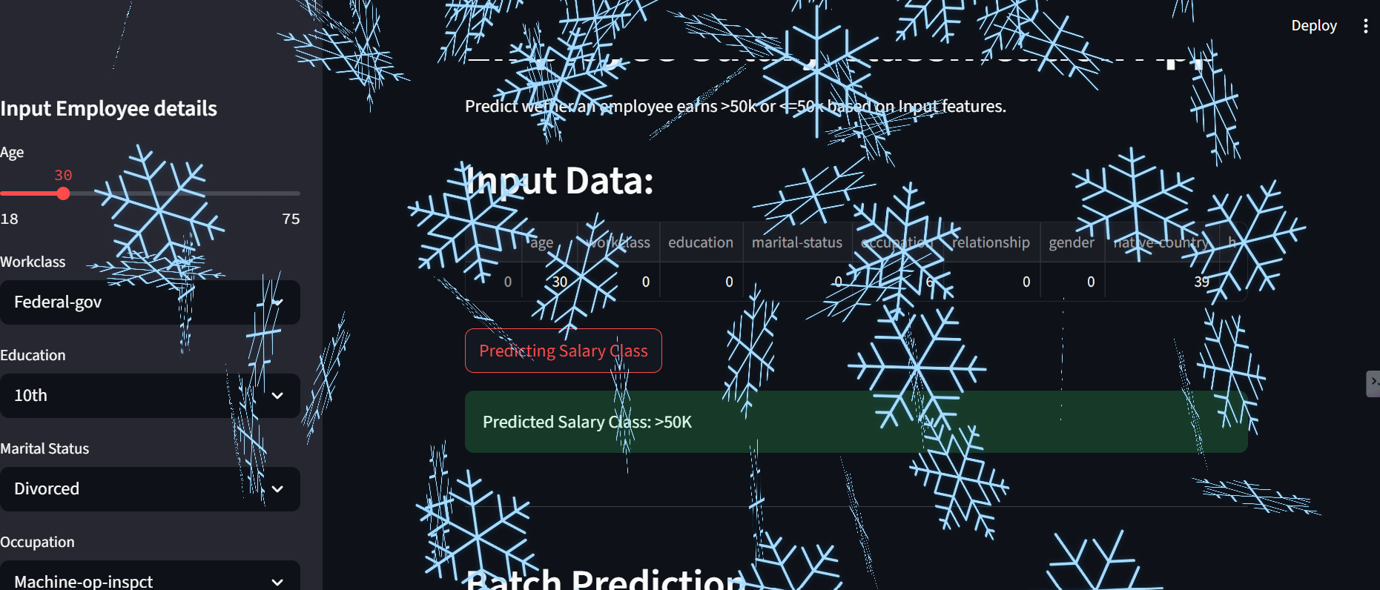
Result

Slide 13
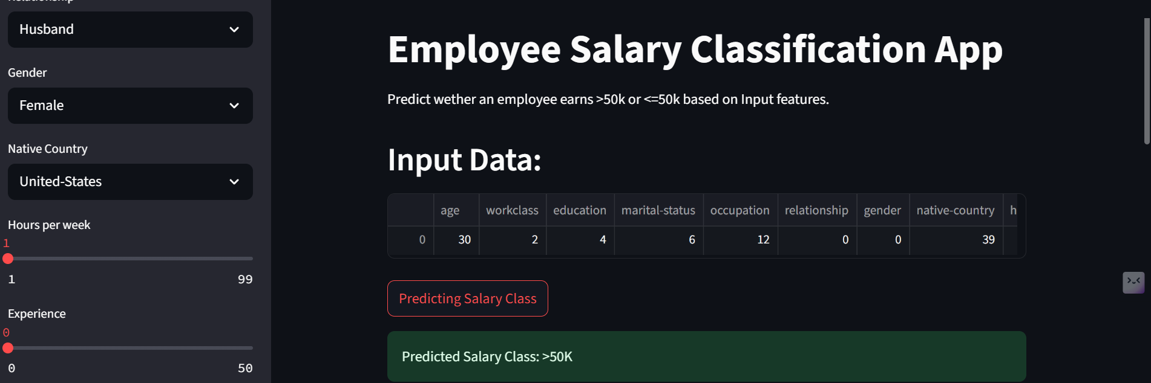
Result

Slide 14
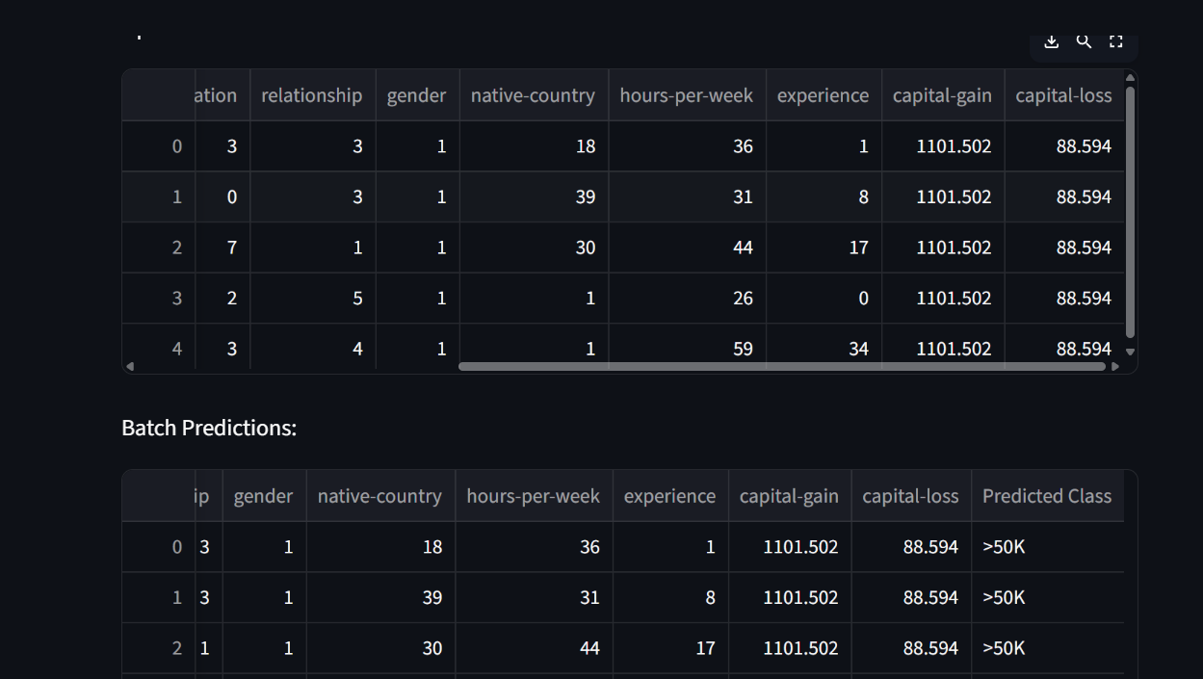
Result

Slide 15
Conclusion
Key Findings:
Model achieved 86% accuracy and 0.82 F1‑score, effectively distinguishing high vs. low earners.
Top predictors: education‑num, hours‑per‑week, occupation, and capital‑gain.
Solution Effectiveness:
Ensemble methods (Random Forest/XGBoost) outperformed basic logistic regression, capturing non‑linear
feature interactions.
Stable performance across cross‑validation folds indicates strong generalization.

Slide 16
Future scope(Optional)
Explore advanced techniques (e.g., SMOTE for balancing, feature embedding for categories).
Integrate explainability tools (SHAP/LIME) to provide transparent salary drivers.
Deploy as a scalable microservice (Kubernetes) with continuous monitoring and retraining pipeline.

Slide 17
References
Dua, D. & Graff, C. (2019). UCI Machine Learning Repository: Adult Dataset (Census Income) URL: https://archive.ics.uci.edu/ml/datasets/adult
Primary dataset used for salary prediction tasks based on demographic attributes.
Kohavi, R. (1996). Scaling Up the Accuracy of Naive-Bayes Classifiers: A Decision-Tree Hybrid Proceedings of the 2nd International Conference on Knowledge Discovery and Data Mining (KDD-96), 202–207.
Demonstrates performance benchmarking using the UCI Adult dataset for classification tasks.

Slide 18
References
Pedregosa et al. (2011). Scikit-learn: Machine Learning in Python Journal of Machine Learning Research, 12, 2825–2830. URL: https://jmlr.org/papers/v12/pedregosa11a.html
Documentation and implementation reference for building ML models used in this project.
Streamlit Documentation. Streamlit: Turn data scripts into shareable web apps in minutes URL: https://docs.streamlit.io
Used for building the interactive user interface for EDA and predictions.

Slide 19
References
Chollet, F. (2018). Deep Learning with Python Manning Publications.
Provides theoretical insights into model design, preprocessing, and data handling.
Pandas Development Team (2020). pandas-dev/pandas: Powerful Python data analysis toolkit URL: https://pandas.pydata.org
For data cleaning, preprocessing, and manipulation in the pipeline.

Slide 20
THANK YOU

